Slide 1
Lesson 17 – Spring MVC

Slide 2
Contents
Model-View-Controller pattern
Spring MVC
Configuration
Controllers
Request Mappings
Responses
Message Converters
Interceptors
Controller Advices

Slide 3
Model-View-Controller
Separate the user interface into three interconnected components: the model, the view and the controller.
The model is the central component of the pattern. It expresses the application's behavior in terms of the problem domain, independent of the user interface. It directly manages the data, logic and rules of the application.
A view can be any output representation of information, such as a chart or a diagram. Multiple views of the same information are possible, such as a bar chart for management and a tabular view for accountants.
The third part or section, the controller, accepts input and converts it to commands for the model or view.

Slide 4
Model-View-Controller
Client
Application
Controller
Model
View
DB

Slide 5
Model-View-Controller
Model
Updates
Manipulates
View
Controller
Sees
Uses
User

Slide 6
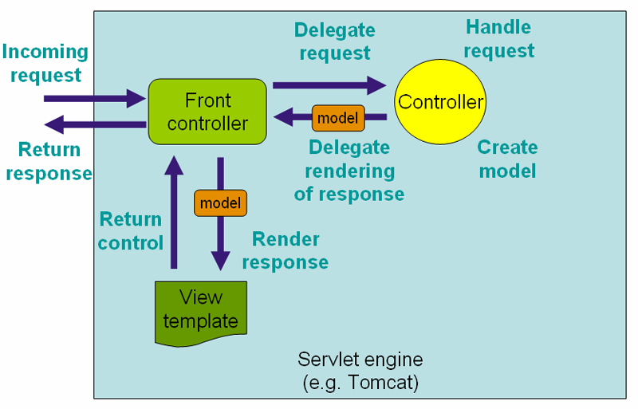
Spring MVC

Slide 7
Spring MVC. Spring Boot solution
Code example

Slide 8
Spring MVC. Controller: Detailed URL Mapping
@RequestMapping accepts the following parameters:
name
path (value)
method (GET/POST/PUT/DELETE...)
params
produces (mimeType)
consumes (mimeType)
Headers
…
Meta Annotations
@GetMapping
@PutMapping
@PostMapping
@RequestMapping
…

Slide 9
Spring MVC. Controller: URL Templates
@PathVariable - to map variables in URL paths
path variables can also be Regular Expressions
You can also do as follows
/message/user/{name}
@RequestParam – request.getParameter(“…”)
@SessionAttribute – request.getSession().getAttribute(“…”)

Slide 10
Spring MVC. Controller: @ModelAttribute
You can also use @ModelAttribute in controller to directly load URL value into the model
A Model can represent objects that can be retrieved from database or files as well
Model should not have logic, rather the controller should get the model and “transform” the model based on the request, while sending it to the View

Slide 11
Spring MVC. View
Spring MVC integrates with many view technologies:
JSP
Velocity
Freemarker
Pebble
Values sent to controller with POST or GET as usual
Values made available to the view by the controller

Slide 12
Message Converters
Any data you return from REST endpoints should be converted to String
By default Spring you can return only String objects (StringHttpMessageConverter)
To extend this functionality Spring supports different message converters
You can implement your custom converter by implementing HttpMessageConverter or use one of predefined converters

Slide 13
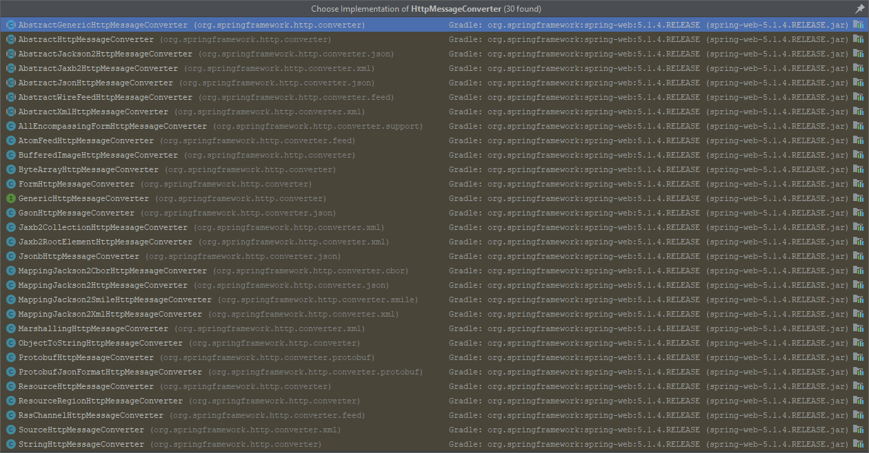
Message Converters. Predefined by Spring

Slide 14
Message Converters. Interceptors. Controller Advice
Code example

Slide 15
Homework
Implement Homework #16 using Spring MVC
Use Controllers instead of Servlets
Use Interceptors to implement request logging
Use exception handlers instead of error mappings in web.xml
Remove web.xml file
Application context should not be created manually and should not be used directly anywhere
Learn and use Thymeleaf instead of writing html in Java

Slide 16
Useful links
Spring - MVC Framework
Spring Tutorial
Spring Framework Documentation
Spring Web

Slide 17
Thanks!
Any Questions?
Or find us in Slack:
@Yaroslav Brahinets
@Vasya Rudas
@Oleksandr Kucher

